Slide 1
<COURSE_TITLE>
Version: 3.0
Trainer: _____________
Course Code: <COURSE_CODE>
Website:www.tertiarycourses.com.sg
Email: enquiry@tertiaryinfotech.com
Tel: +65 6100 0613

Slide 2
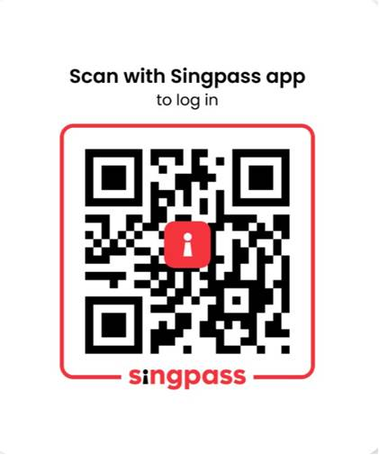
Digital Attendance
It is mandatory for you to take both AM and PM digital attendance especially for WSQ courses.
The trainer or administrator will show you the digital attendance QR code generated from TPG.
Please scan the QR code from your Singpass App and submit your attendance.

Slide 3


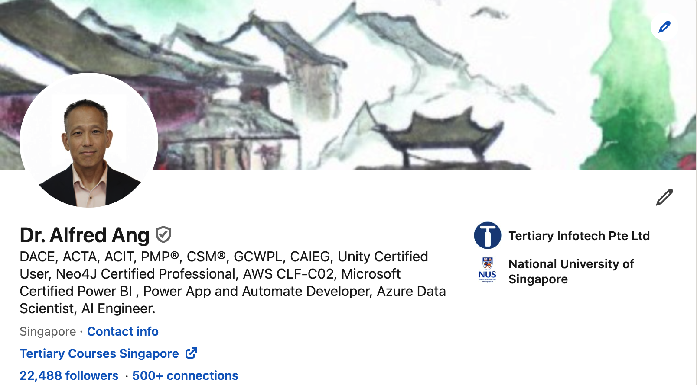









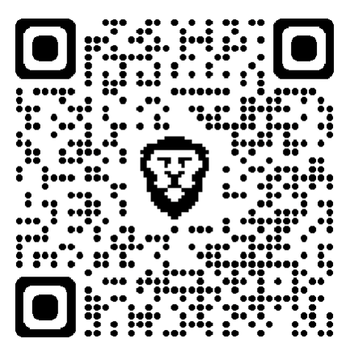



About the Trainer
3

Slide 4

About the Trainer
Please add the following info to this page
Screenshot of your LInkedin Profile (with profile image)
QR code to your Linkedin
Certifications eg PL-100, AWS, CISA….
Sample below

Slide 5

Let's Know Each Other...

Slide 6
Ground Rules
Set your mobile phone to silent mode
Participate actively in the class. No question is stupid.
Mutual respect. Agree to disagree.
One conversation at one time.
Be punctual. Back from breaks on time.
Exit the class silently if you need to step out for phone call, toilet break etc.
75% attendance is required

Slide 7
<COURSE_OUTLINE>

Slide 8
Access Google Classroom LMS
You can access more resources from Google classroom LMS
https://classroom.google.com/c/NjcyMjU4NzA1OTgz?cjc=ipnbph2
Alternatively. You can goto https://classroom.google.com and enter the class code on the top right.
Google Class code: ipnbph2

Slide 9
<TOPICS_OUTLINE>

Slide 10
Summary
Q&A

Slide 11
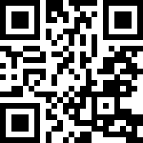
Feedback
Kindly submit your course feedback below
https://goo.gl/R2eumq

Slide 12


CERTIFICATE
of ACCOMPLISHMENT
You will receive a digital certificate in your email
after the completion of the class
If you did not receive the digital certificate,
please send your request to
enquiry@tertiaryinfotech.com
Notes:
12

Slide 13
Thank You!

